Slide 1
Chip’s Core Escape
Puzzle Maze
Creators:
Keegan Erickson
Jessica Story
Ethan Talbert
Advisor:
Dr. Basnet, Ram

Slide 2
Object Oriented Programming Final Project
Task:
To create an object oriented programming (OOP) project
Decided on:
Maze/puzzle game
Pygame library
Divided Project into 3 sub-projects
Main Menu & state transition
Game loop & logic
Game objects & interaction
Management/communication
Github, Github Issues
Discord

Slide 3
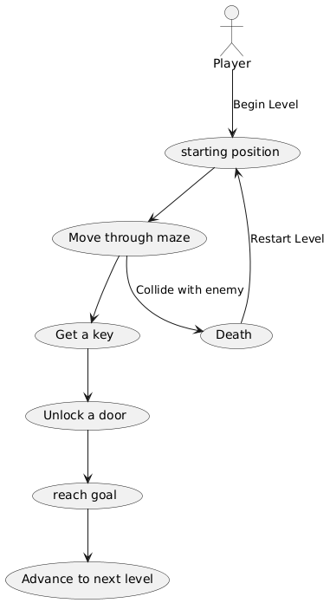
Conceptual
Flow

Slide 4
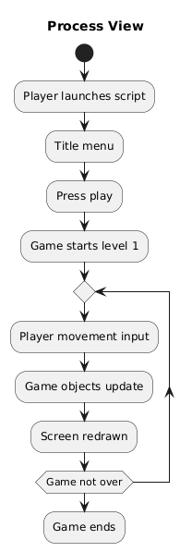
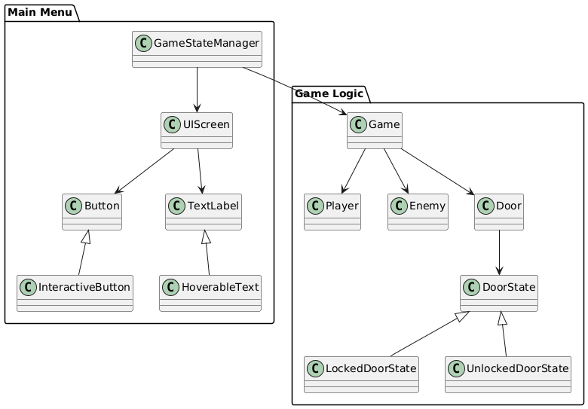

Slide 5
Design Patterns and OOD Concepts
Design Patterns
Template
Used in game.py
State
Used in GameObjects.py,
Used in interactive_ui_elements.py,
Used in game_states.py
Singleton
Used in game_states.py
Decorator
Used in ui_elements.py
OOD Concepts
Inheritance and Polymorphism
It was used in creating the Enemy and Player class
Abstraction
The TileSet class uses this
Getters and Setters
Used by the state class
Notes:
Ethan

Slide 6
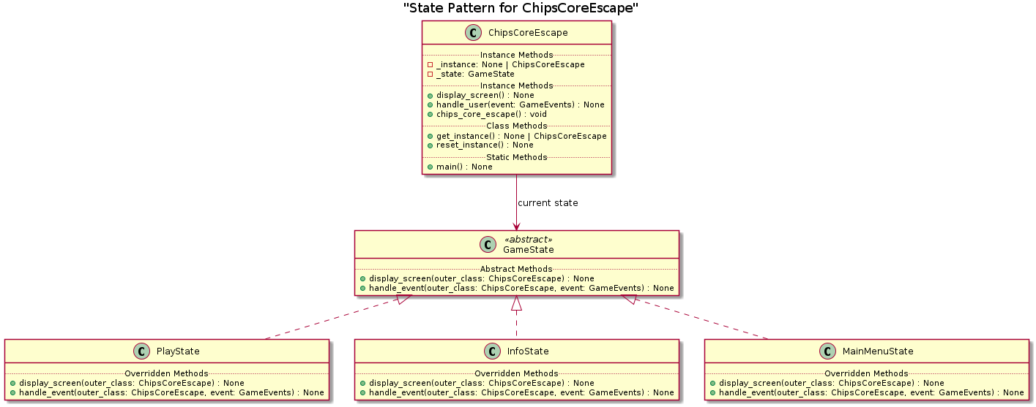
Game State Control

Slide 7
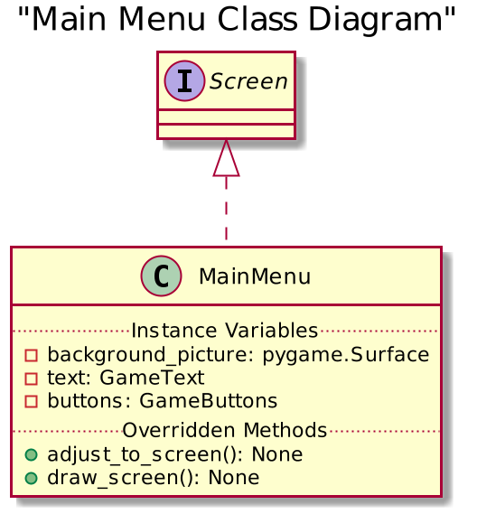
Main Menu

Slide 8
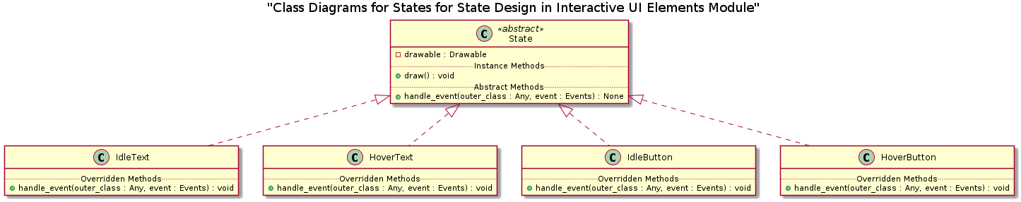
Interactive Elements

Slide 9
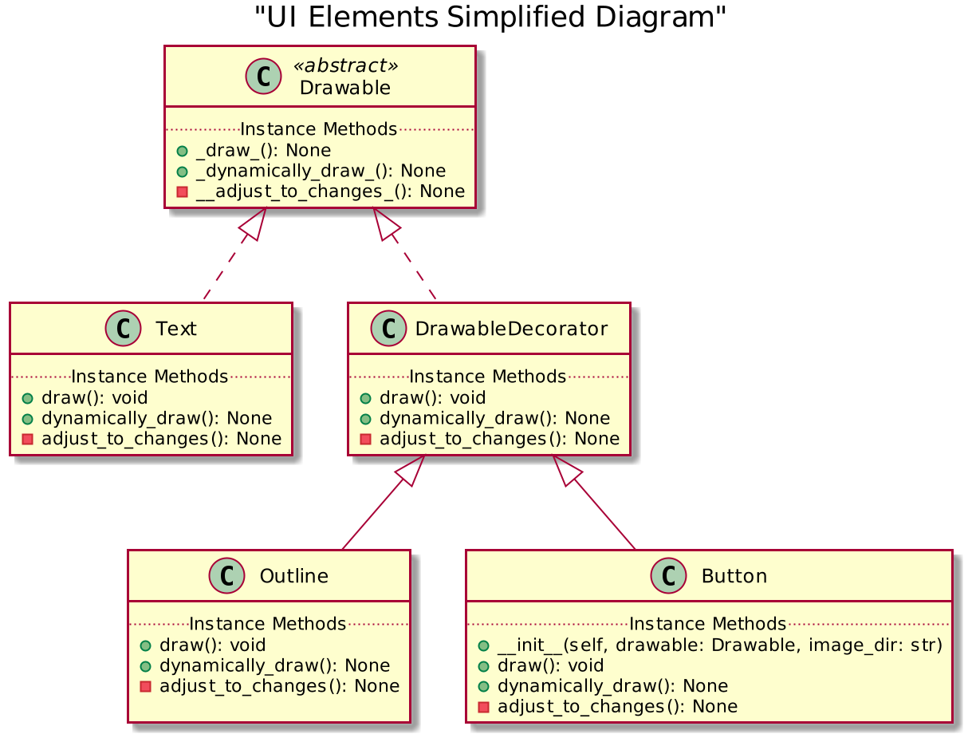
UI Elements

Slide 10
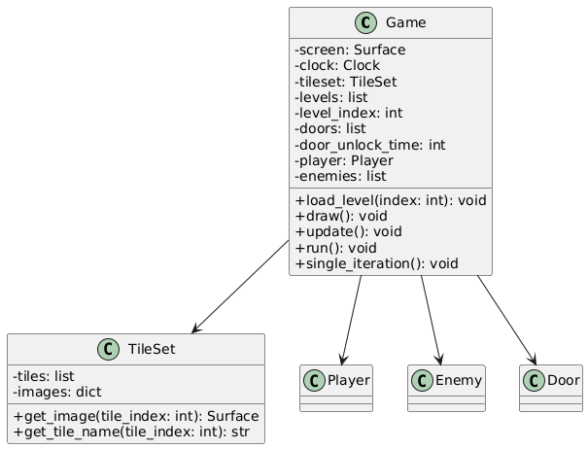
Game Loop
Notes:
Ethan

Slide 11
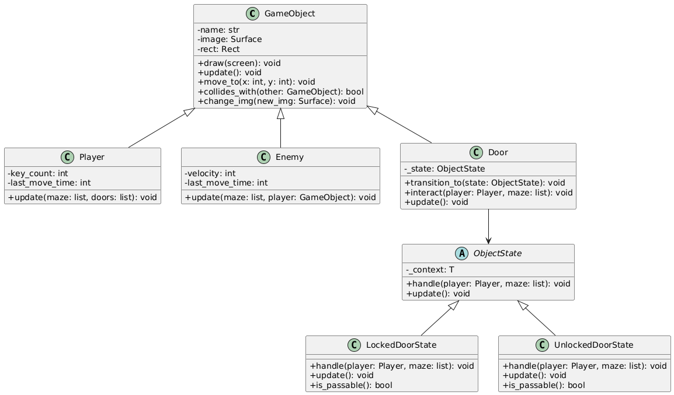
Game Objects
Notes:
Ethan

Slide 12
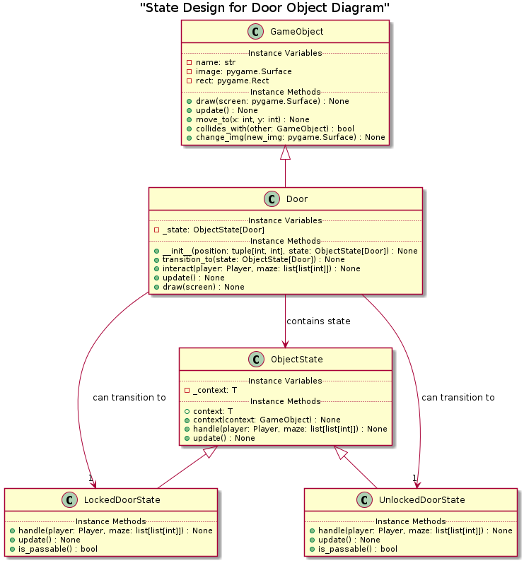
Notes:
Ethan?

Slide 13
Demo

Slide 14
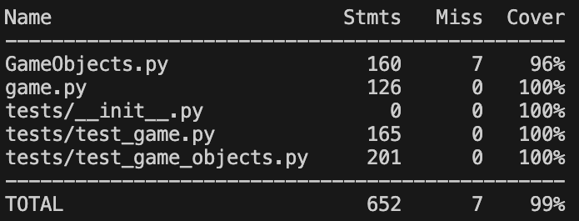
Testing
Property-Based Testing
Generated random start positions and movements to validate player and movement logic across the grid
Dependency Isolation
Use simple dummy objects Instead of real graphics so tests run fast and anywhere
Notes:
Ethan

Slide 15
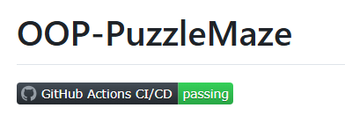
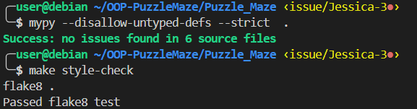
Best Practices
CI/CD Results
Passed CI/CD tests on Github by following CI/CD pipeline
Mypy and Flake8 Results
Adhered to Pep8 conventions throughout program

Slide 16
Takeaways
Object interaction logic is tricky in a game
Getting a door to work harder than players and enemies
Learning to manage a multi-person project on Github
Merge conflicts
Testing a GUI is difficult
Initially done manually
Good opportunity to apply OOP

Slide 17
Questions

